Slide 1
Database Management System BCS403
By
Mr. Md. Tahir Mirji
Assistant Professor
Dept. of AIML, AIT Bangalore

Slide 2
Module 3
Normalization: Database Design Theory – Introduction to Normalization using Functional and Multivalued Dependencies: Informal design guidelines for relation schema, Functional Dependencies, Normal Forms based on Primary Keys, Second and Third Normal Forms, Boyce-Codd Normal Form, Multivalued Dependency and Fourth Normal Form, Join Dependencies and Fifth Normal Form.
SQL: SQL data definition and data types, Schema change statements in SQL, specifying constraints in SQL, retrieval queries in SQL, INSERT, DELETE, and UPDATE statements in SQL, Additional features of SQL
Dept. of AIML

Slide 3

Four informal guidelines that may be used as measures to determine the quality of relation schema design:
Making sure that the semantics of the attributes is clear in the schema
Reducing the redundant information in tuples
Reducing the NULL values in tuples
Disallowing the possibility of generating spurious tuples
Dept. of AIML

Slide 4
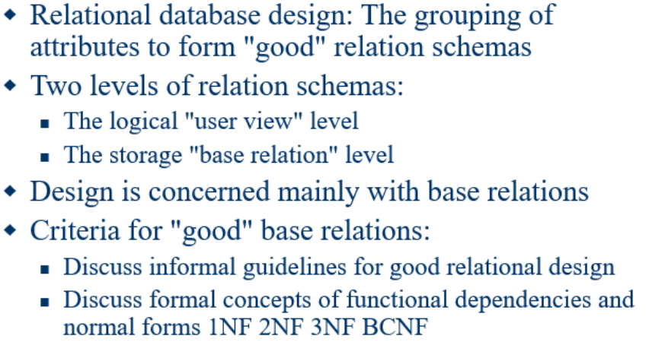
Dept. of AIML

Slide 5

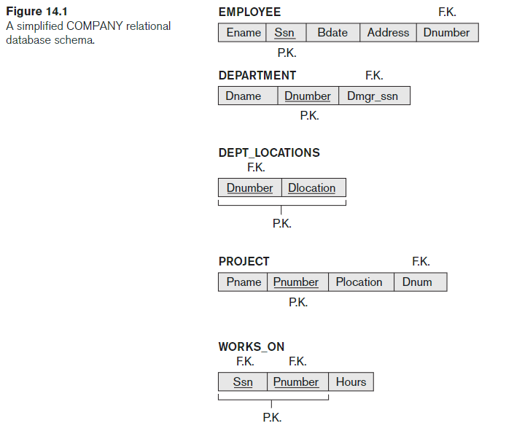
Dept. of AIML

Slide 6
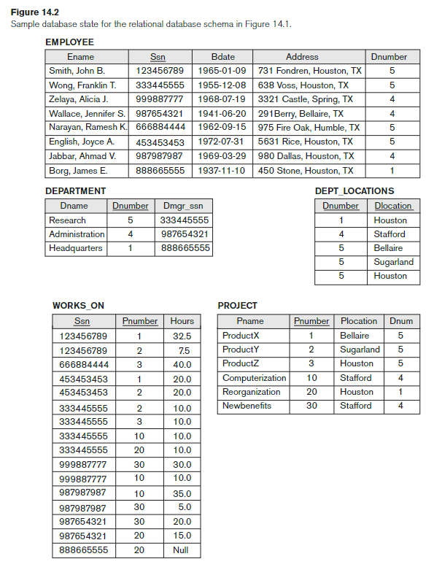
Dept. of AIML

Slide 7
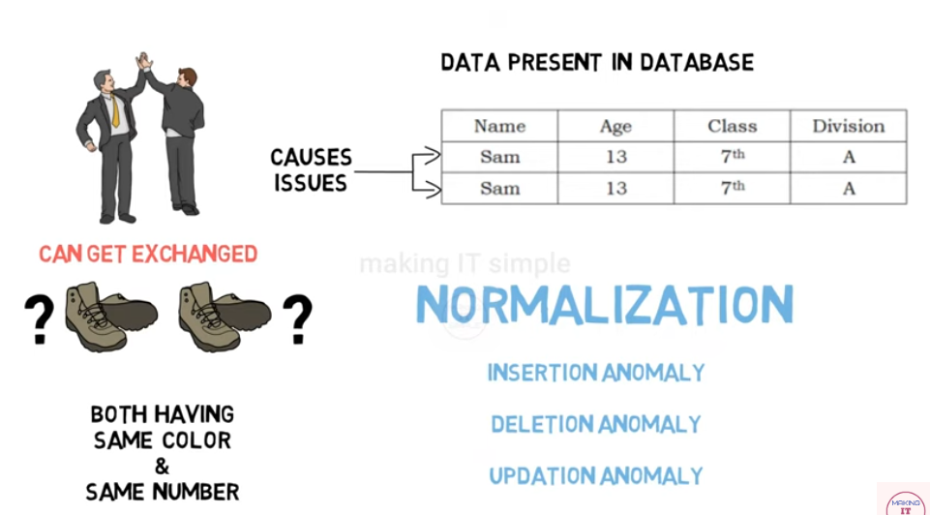
Dept. of AIML

Slide 8
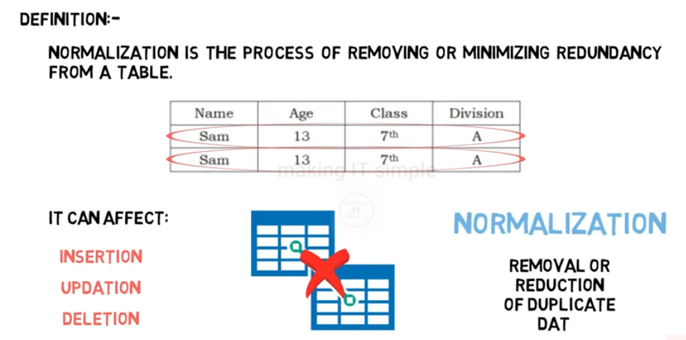
Dept. of AIML

Slide 9
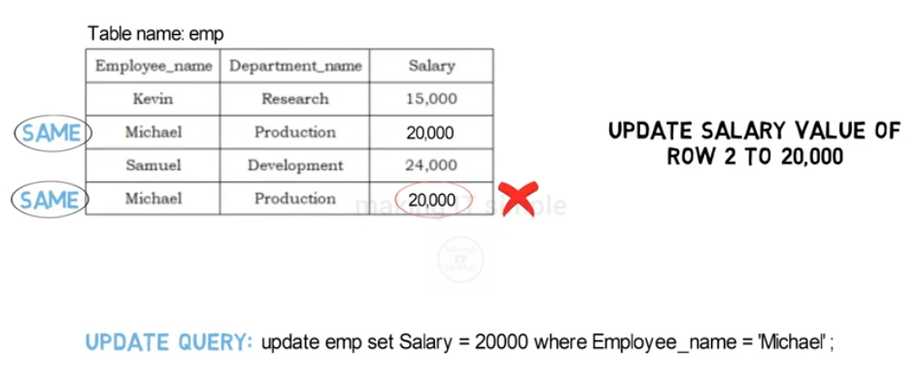
Dept. of AIML

Slide 10
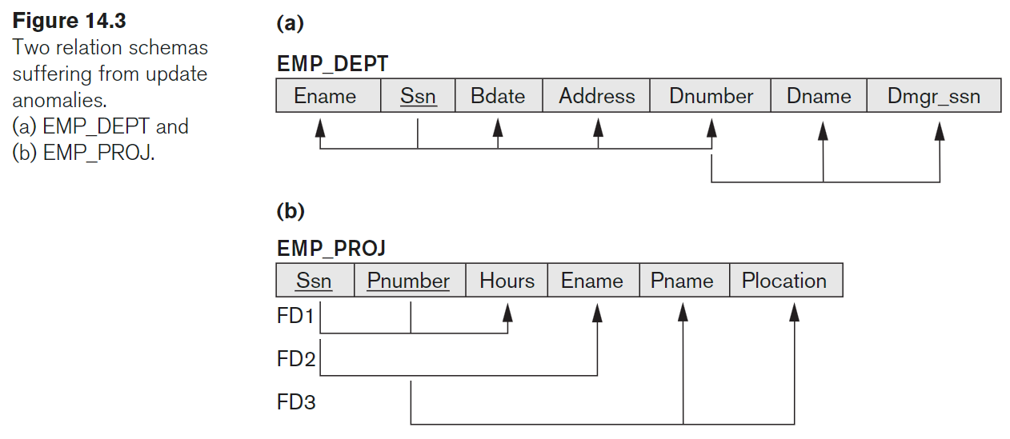
Guideline I: Informally, each tuple in a relation should represent one entity or relationship instance. (Applies to individual relations and their attributes).
– Attributes of different entities (EMPLOYEEs, DEPARTMENTs, PROJECTs) should not be mixed in the same relation
– Only foreign keys should be used to refer to other entities
Dept. of AIML

Slide 11
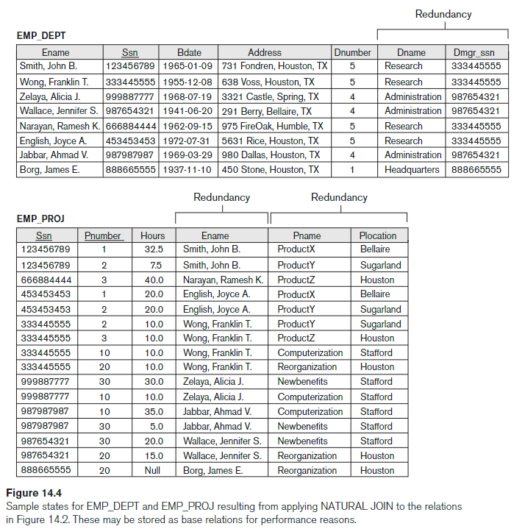
Dept. of AIML

Slide 12
The anomalies occurring while modifying database can be classified briefly into three types.
Insertion Anomalies: This anomaly is caused when insertion of a new data(tuple) inside a relationship is not possible because of absence of some data.
Updation Anomalies: When numerous rows of data must be updated in order to update a single data value, this is known as an update anomaly.
Deletion Anomalies: The term "deletion anomaly" describes a circumstance in which some vital data is unintentionally lost when some other data is deleted.
Dept. of AIML

Slide 13
Update anomaly
The update anomaly: refers to a situation where an update of a single data value requires multiple tuples (rows) of data to be updated.
Consider the relation: – EMP_PROJ(Emp#, Proj#, Ename, Pname, No_hours)
Update Anomaly:
– Changing the name of project number P1 from “Billing” to “Customer-Accounting” may cause this update to be made for all 100 employees working on project P1.
Dept. of AIML

Slide 14
Insert anomaly
The insert anomaly: refers to a situation where in one cannot insert a new tuple into a relation because of an artificial dependency on another relation.
Consider the relation: – EMP_PROJ(Emp#, Proj#, Ename, Pname, No_hours)
Insert Anomaly:
– Cannot insert a project unless an employee is assigned to it. Conversely
– Cannot insert an employee unless an he/she is assigned to a project.
Dept. of AIML

Slide 15
Delete anomaly
The deletion anomaly: refers to a situation where in a deletion of data about one particular entity causes unintended loss of data that characterizes another entity.
Consider the relation: – EMP_PROJ(Emp#, Proj#, Ename, Pname, No_hours)
Delete Anomaly:
–When a project is deleted, it will result in deleting all the employees who work on that project.
– Alternately, if an employee is the sole employee on a project, deleting that employee would result in deleting the corresponding project
Dept. of AIML

Slide 16
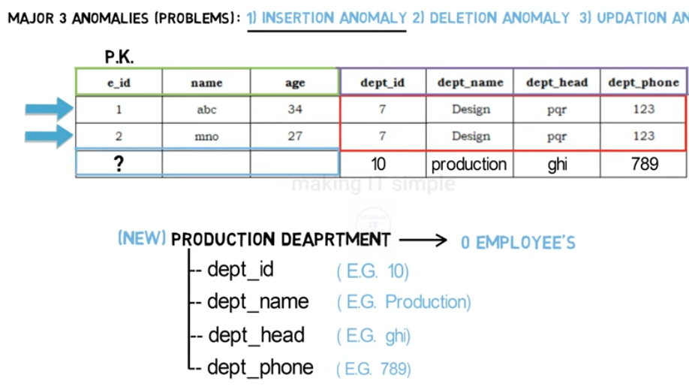
Dept. of AIML

Slide 17
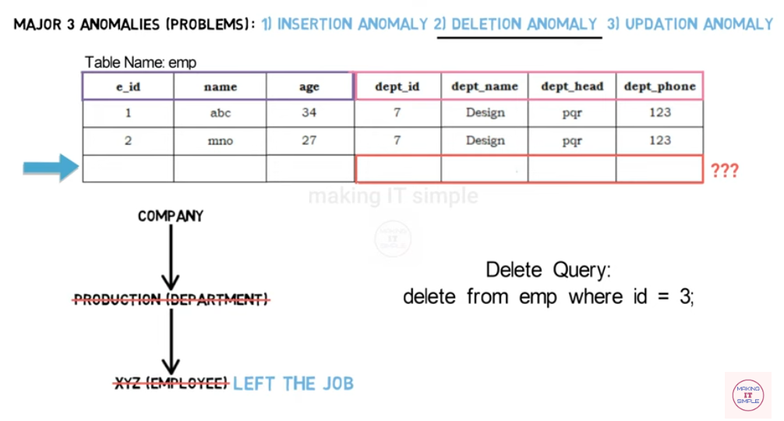
Dept. of AIML

Slide 18
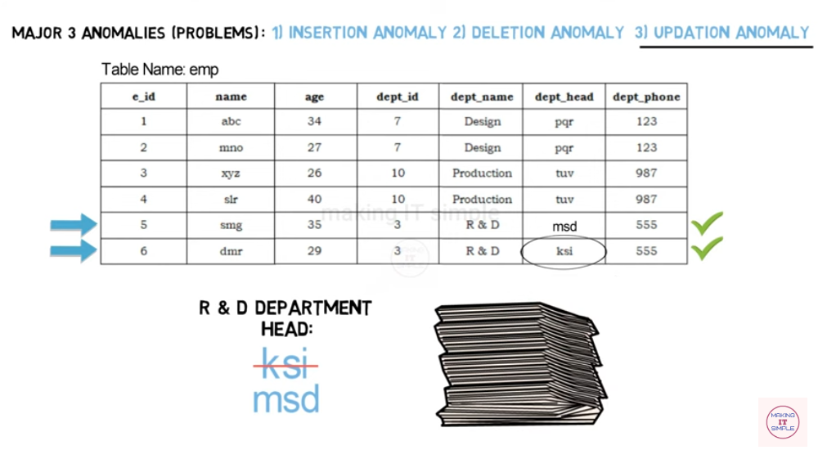
Dept. of AIML

Slide 19
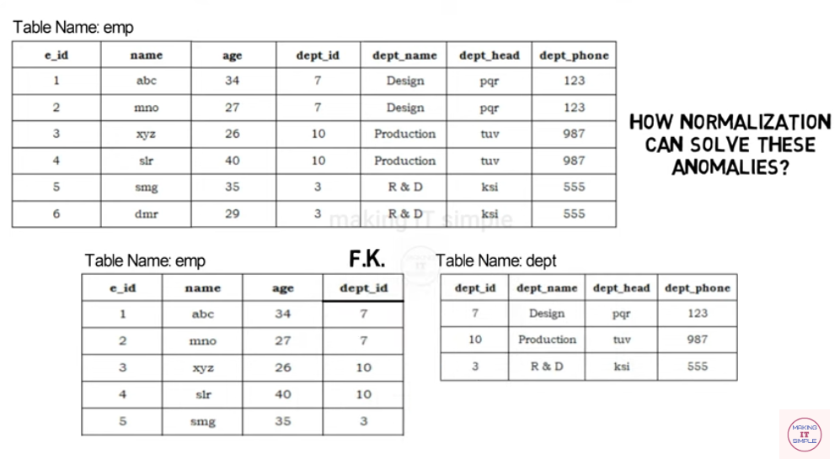
Dept. of AIML

Slide 20
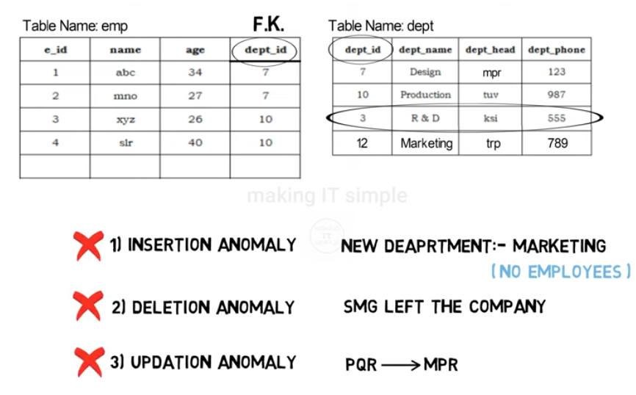
Dept. of AIML

Slide 21

Guideline II:
– Design a schema that does not suffer from the insertion, deletion and update anomalies.
– If there are any anomalies present, then note them so that applications can be made to take them into account.
Dept. of AIML

Slide 22

Guideline III:
As far as possible, avoid placing attributes in a base relation whose
values may frequently be NULL.
If NULLs are unavoidable, make sure that they apply in exceptional cases only and do not apply to a majority of tuples in the relation
Dept. of AIML

Slide 23

Guideline IV
Design relation schemas so that they can be joined with equality
conditions on attributes that are appropriately related (primary key, foreign key) pairs in a way that guarantees that no spurious tuples are generated
Avoid relations that contain matching attributes that are not (foreign key, primary key) combinations because joining on such attributes may produce spurious tuples.
Dept. of AIML
How to avoid Spurious tuples
To prevent spurious tuples, ensure that joins are always performed on primary or foreign keys, which guarantee a valid relationship between the joined tables

Slide 24
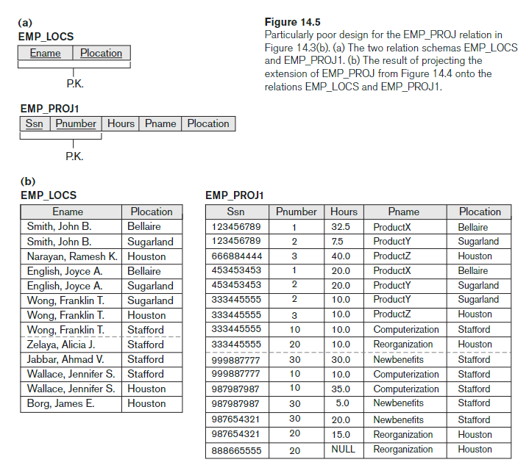
Dept. of AIML

Slide 25
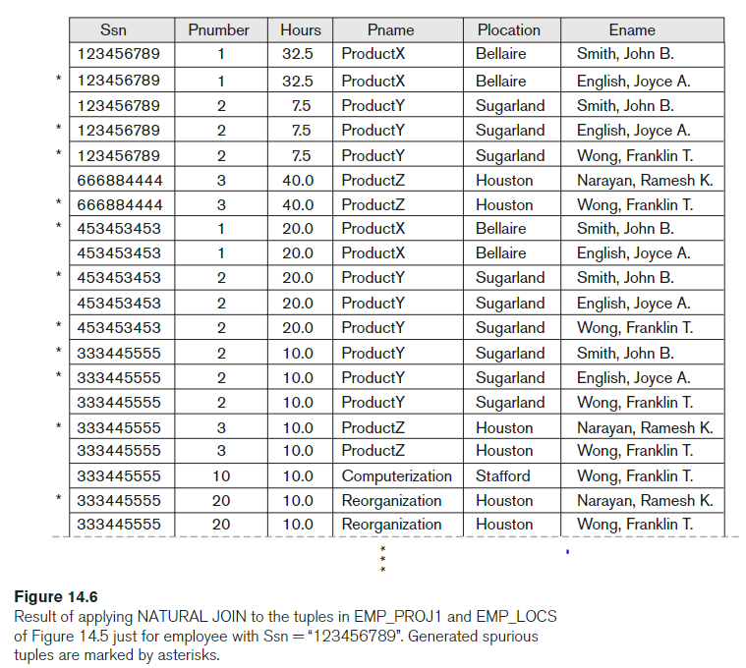
Dept. of AIML

Slide 26

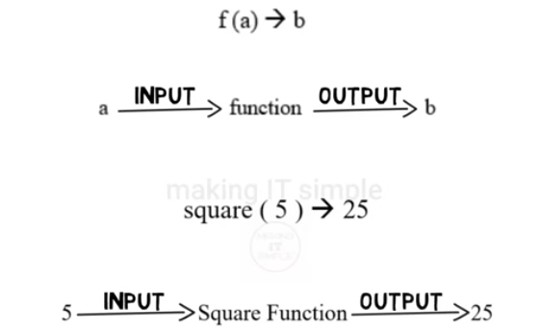
A functional dependency (FD) describes a relationship between attributes where one attribute (the determinant) uniquely determines the value of another attribute (the dependent). It's a constraint that helps maintain data integrity and consistency.
Dept. of AIML

Slide 27
A set of attributes X functionally determines a set of attributes Y if the value of X determines a unique value for Y
X  Y holds if whenever two tuples have the same value for X, they must have the same value for Y
For any two tuples t1 and t2 in any relation instance r(R): If t1[X]=t2[X], then t1[Y]=t2[Y]
X  Y in R specifies a constraint on all relation instances r(R)
Dept. of AIML

Slide 28
Examples of FD constraints
Social security number determines employee name SSN  ENAME
Project number determines project name and location PNUMBER  {PNAME, PLOCATION}
Employee ssn and project number determines the hours per week that the employee works on the project {SSN, PNUMBER}  HOURS
Dept. of AIML

Slide 29
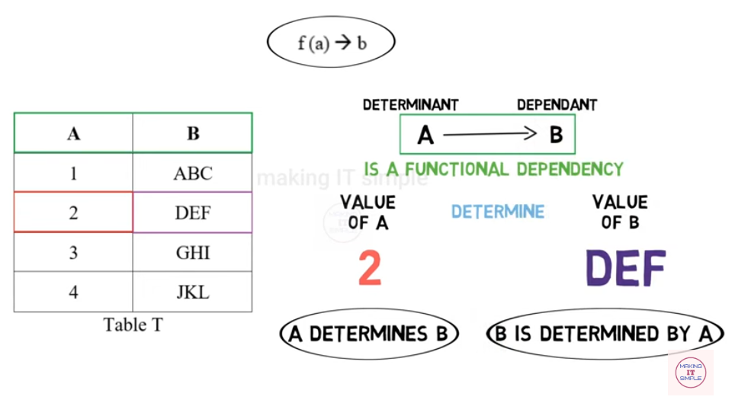
Dept. of AIML

Slide 30
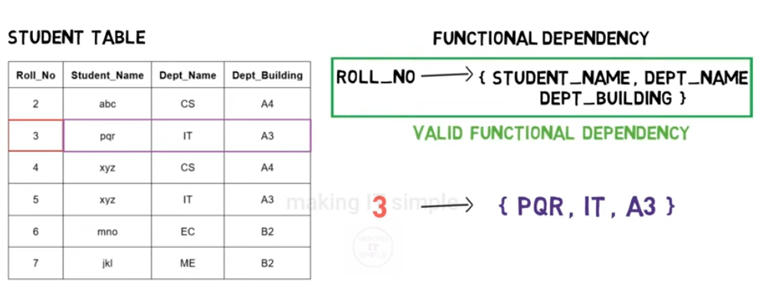

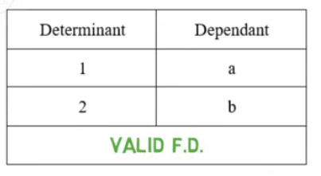
Dept. of AIML

Slide 31
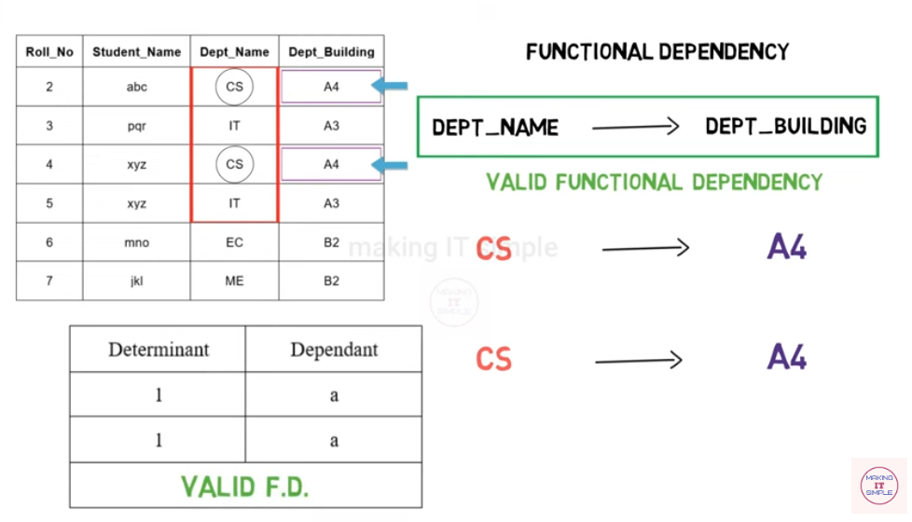
Dept. of AIML

Slide 32
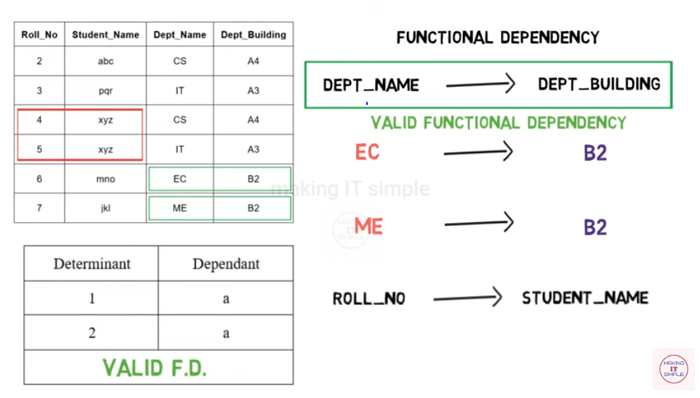
Dept. of AIML

Slide 33
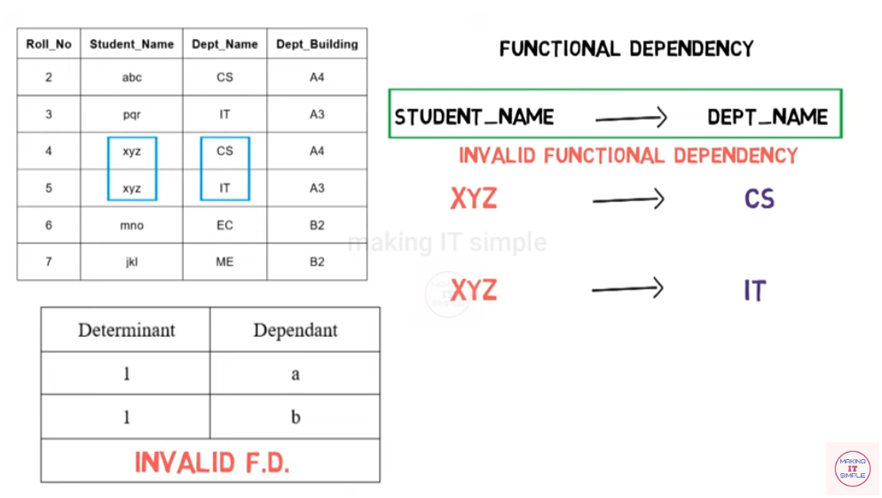
Dept. of AIML

Slide 34
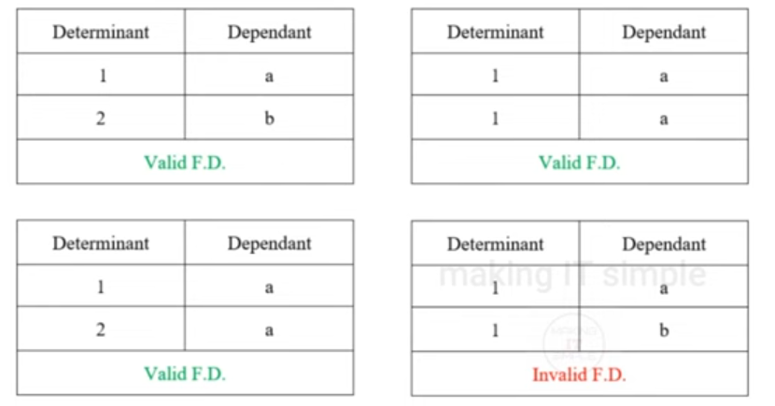
Dept. of AIML

Slide 35

The process of decomposing unsatisfactory "bad" relations by breaking up their attributes into smaller relations
Normalization of data can be considered a process of analyzing the given relation schemas based on their FDs and primary keys to achieve the desirable properties of
(1) minimizing redundancy
(2) minimizing the insertion, deletion, and update anomalies
Dept. of AIML

Slide 36
Normalization theory is based on the concepts of normal forms.
A relational table is said to be a particular normal form if it satisfied a certain set of constraints.
Edgar F. Codd originally established three normal forms: 1NF, 2NF and 3NF.
There are now others that are generally accepted, but 3NF is widely considered to be sufficient for most applications.
Most tables when reaching 3NF are also in BCNF (Boyce-Codd Normal Form).
Dept. of AIML

Slide 37
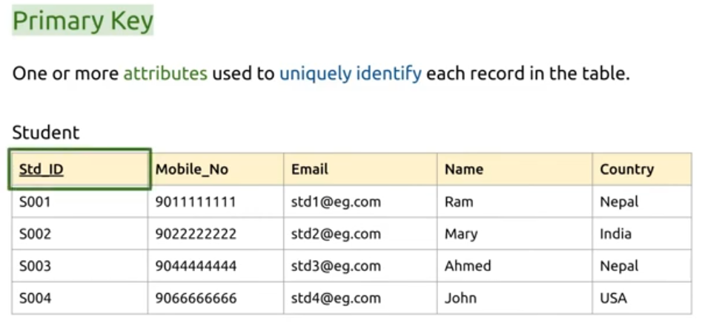
Definitions of Keys and Attributes Participating in Keys
Dept. of AIML

Slide 38
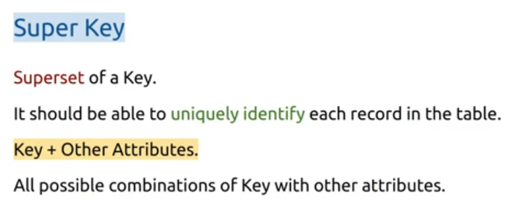
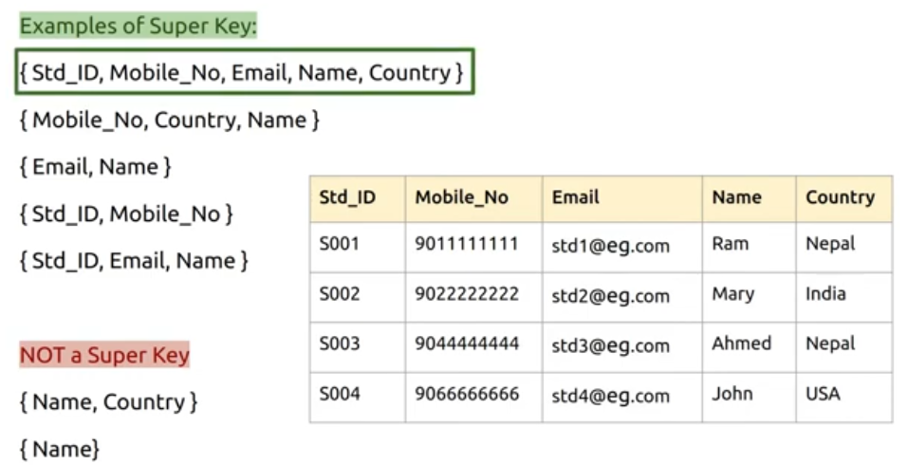
Dept. of AIML

Slide 39
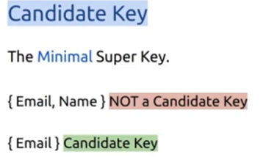

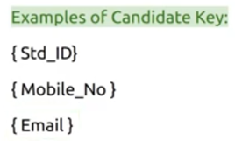
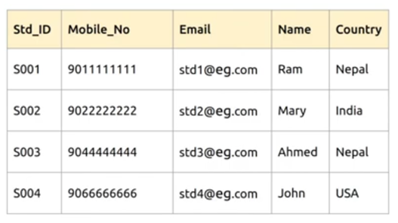
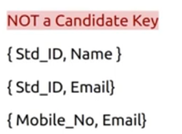
Dept. of AIML

Slide 40
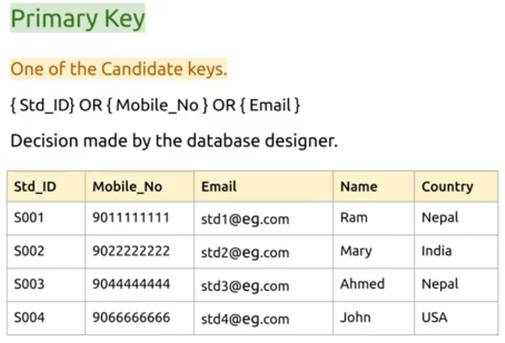
Dept. of AIML

Slide 41

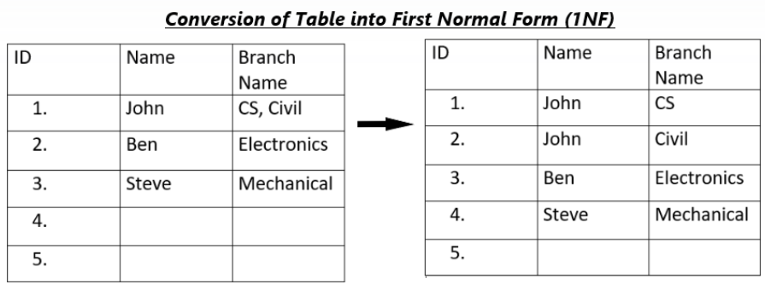
The first Normal Form or 1NF is the most simple normal form.
The only attribute values permitted by 1NF are single atomic (or indivisible) values.
Dept. of AIML

Slide 42
student_id | student_name | student_subjects
101 | Anitha | Math, Science
102 | Ankitha | Science, English
103 | Aryan | Math
This table is transformed into the below table after the application of 1NF
student_id | student_name | student_subjects
101 | Anitha | Maths
101 | Anitha | Science
102 | Ankitha | Science
102 | Ankitha | English
103 | Aryan | Math
Dept. of AIML

Slide 43
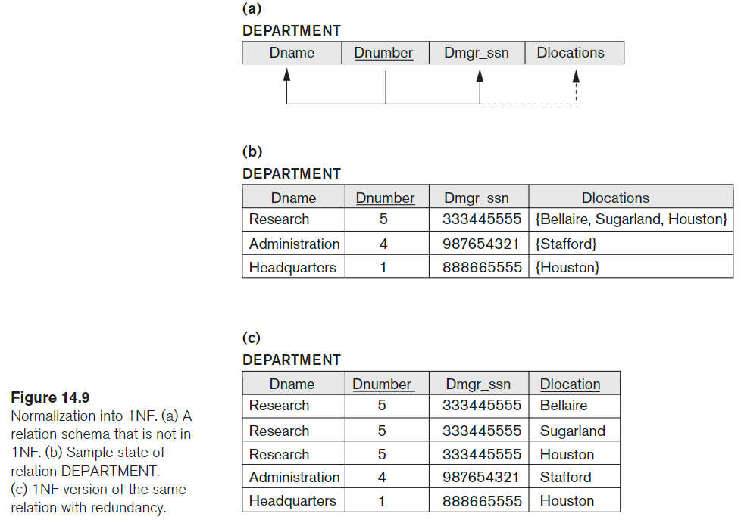
Dept. of AIML

Slide 44

For a relational table to be in second normal form, it must satisfy the following rules:
The table must be 1NF.
It must not contain any partial dependency, i.e., all non-prime attributes are fully functionally dependent on the primary key.
{Ssn, Pnumber} → Hours is a full dependency (neither Ssn → Hours
nor Pnumber → Hours holds).
However, the dependency {Ssn, Pnumber} → Ename is partial because Ssn → Ename holds.
Dept. of AIML

Slide 45
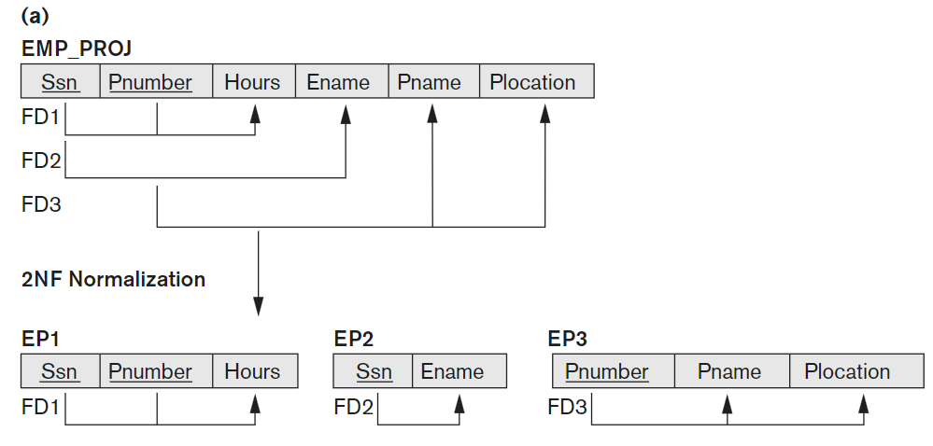
Dept. of AIML

Slide 46
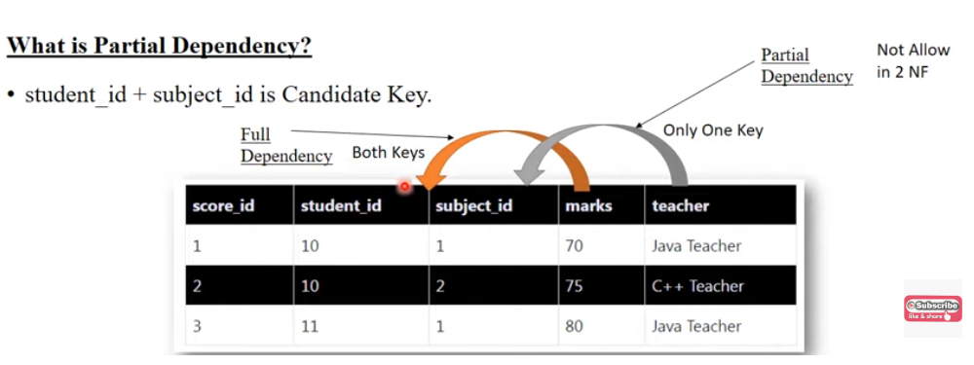
Dept. of AIML

Slide 47
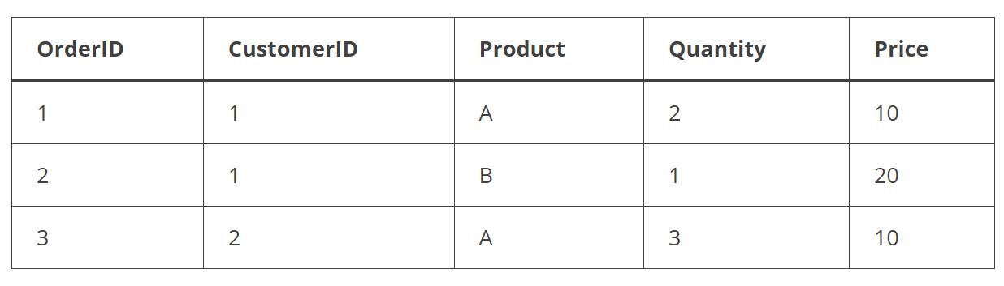
Orders” that stores information about customer orders.
Dept. of AIML
Price column depends on the Product column and the primary key is composed of OrderID and CustomerID.
The table is not in 2NF because the Price column is functionally dependent on only part of the primary key (Product) and not on the whole primary key (OrderID and CustomerID).
To bring this table to 2NF, we need to separate the table into two separate tables: one for the Orders and one for the Products.

Slide 48
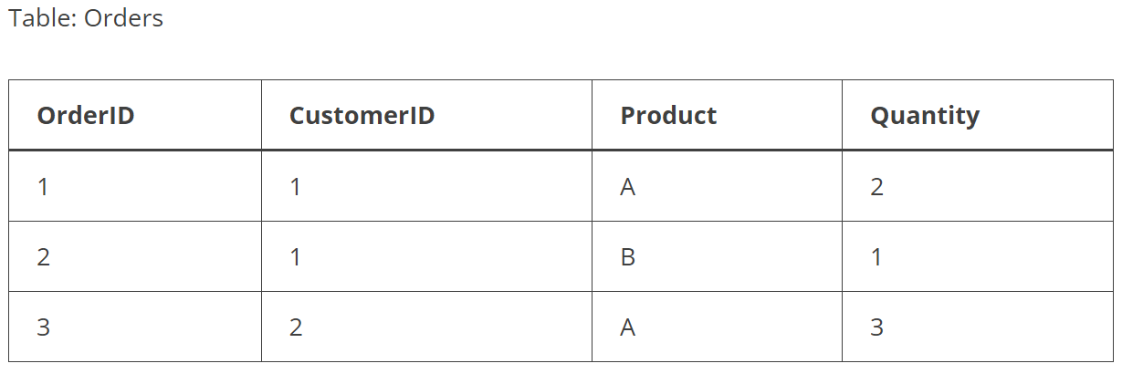
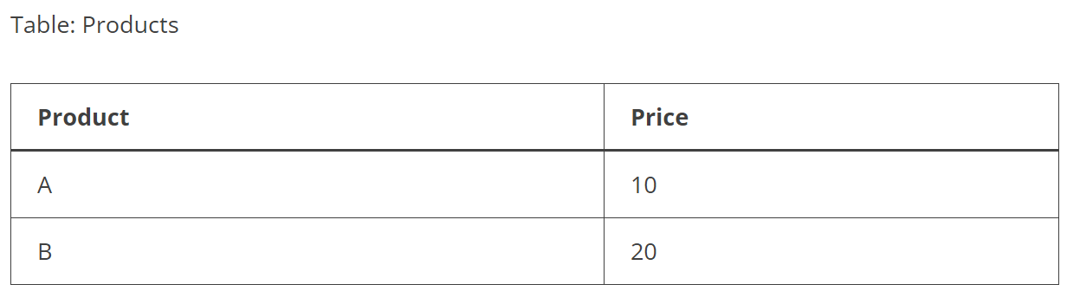
Orders” that stores information about customer orders.
Dept. of AIML

Slide 49
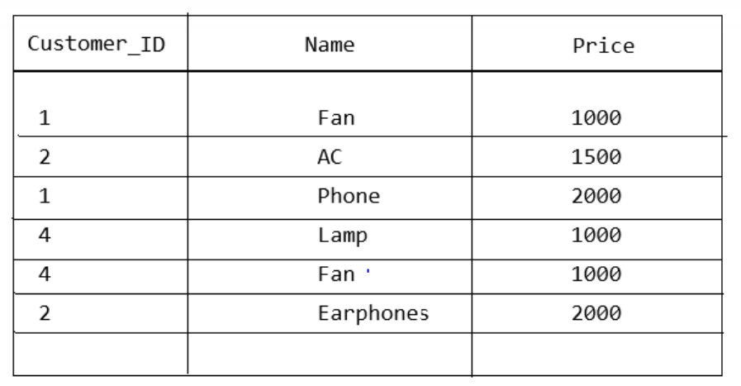
Suppose there is a table ‘Product’ containing the Customer ID, Product Name, and Price of Products.
Dept. of AIML
Candidate Keys are {Customer_ID, Name}.
The Prime Attributes ( attributes that are a part of the candidate key) will be Customer_ID and Name and the Non-Prime Attribute will be Price.
Customer_ID->Price is a Partial Functional Dependency because Price (non-prime attribute) depends on Customer_ID(a subset of the candidate key).

Slide 50
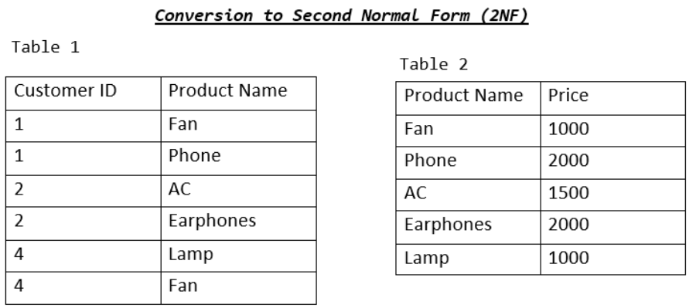
Dept. of AIML

Slide 51

The Third Normal Form exists in a table if:
It exists in the 2NF.
Has no transitive dependency exists.
A transitive dependency exists when a non-primary key column depends on another non-primary key column, rather than on the primary key.
Dept. of AIML

Slide 52
student_id | student_name | student_state | student_city | student_pincode
101 | Ananya | Karnataka | Mysore | 570010
102 | Anitha | Karnataka | Bengaluru | 560010
103 | Ankitha | Tamilnadu | Chennai | 600010
104 | Aryan | Andhra | Tirupati | 517502
105 | Brijesh | Tamilnadu | Coimbatore | 641001
{student_id} is the Candidate Key (an attribute that identifies the tuple uniquely). All the other attributes are non-prime attributes.
student_state and student_city are dependant on student_pincode which is inturn dependant on student_id.
This forms a transitive dependancy between the non prime attributes(student_state, student_city) and candidate key(student_id) and hence violating the third point given above.
Hence, this relation is not in 3NF.
Dept. of AIML

Slide 53
Transitive dependency
if Student ID determines Student’s City then Student ID -> Student City is a Functional Dependency.
And, if Student’s State is determined by Student’s City then Student City->Student State is also a Functional Dependency.
But, Student City is a Non-Prime Attribute that depends on Student ID (Prime Attribute). Therefore, Student State becomes indirectly dependent upon Student ID. We conclude that If Student ID -> Student City and Student City->Student State exists, then Student ID->Student State also exists.
Dept. of AIML

Slide 54
student_id | student_name | student_state | student_city | student_pincode
101 | Ananya | Karnataka | Mysore | 570010
102 | Anitha | Karnataka | Bengaluru | 560010
103 | Ankitha | Tamilnadu | Chennai | 600010
104 | Aryan | Andhra | Tirupati | 517502
105 | Brijesh | Tamilnadu | Coimbatore | 641001
Student Table
Student_Address Table
Dept. of AIML
student_id | student_name | student_pincode
101 | Ananya | 570010
102 | Anitha | 560010
103 | Ankitha | 600010
104 | Aryan | 517502
105 | Brijesh | 641001
student_pincode | student_state | student_city
570010 | Karnataka | Mysore
560010 | Karnataka | Bengaluru
600010 | Tamilnadu | Chennai
517502 | Andhra | Tirupati
641001 | Tamilnadu | Coimbatore

Slide 55

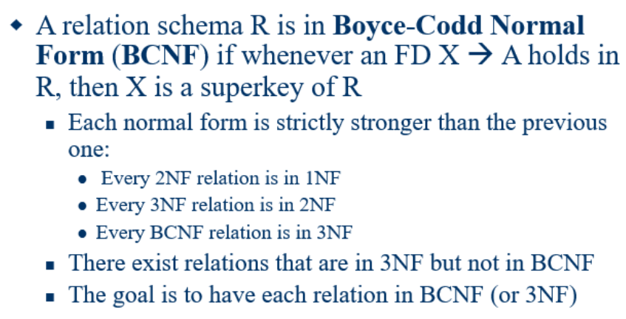
Dept. of AIML

Slide 56
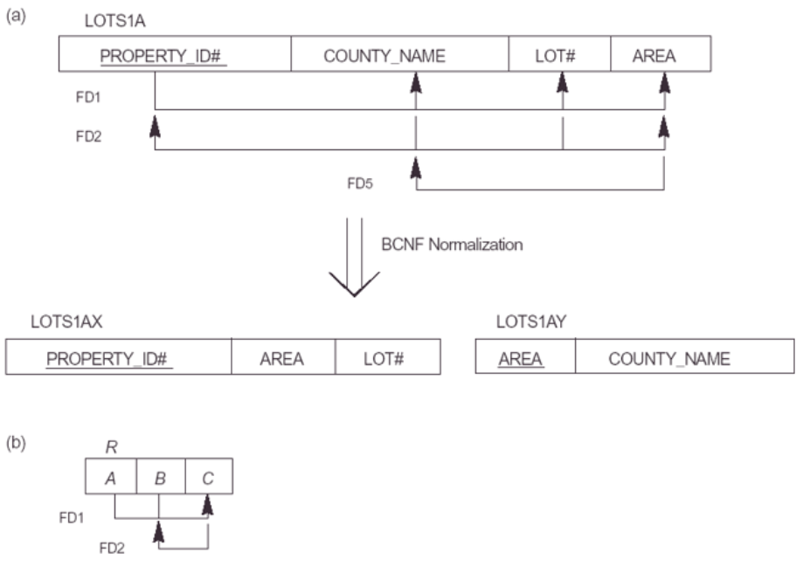
Dept. of AIML

Slide 57
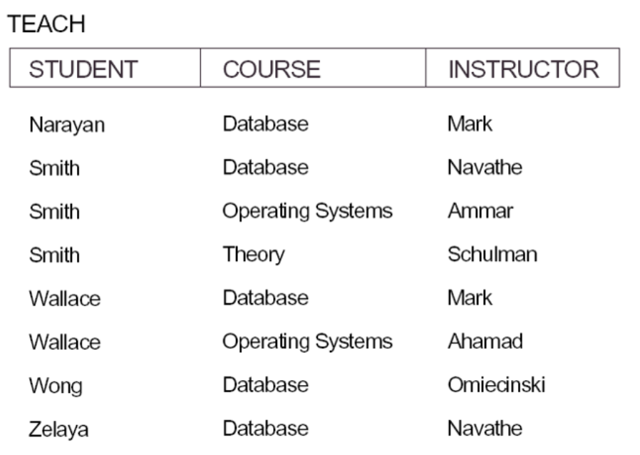
Dept. of AIML

Slide 58

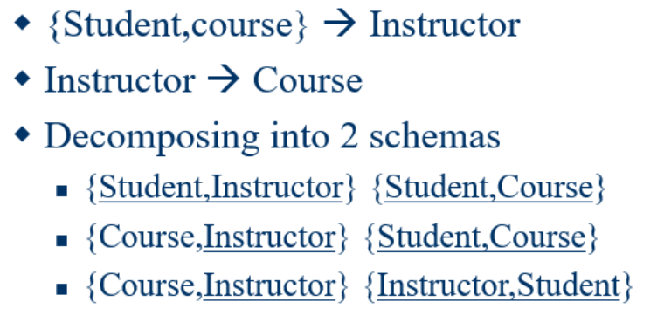
Dept. of AIML

Slide 59

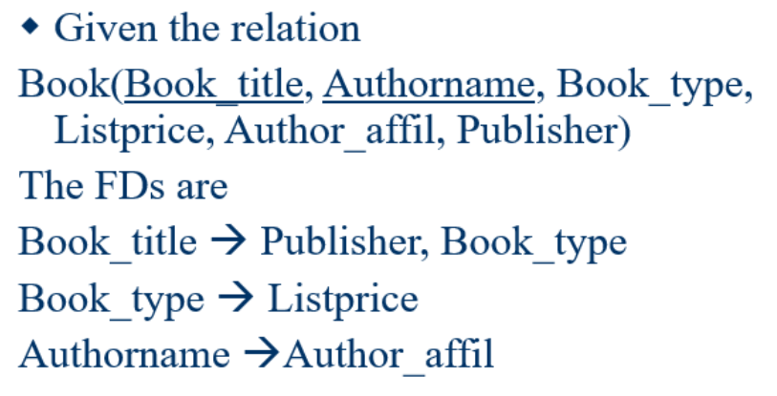
Dept. of AIML

Slide 60
5. Multivalued Dependencies and Fourth Normal Form (1)
Definition:
A multivalued dependency (MVD) X —>> Y specified on relation schema R, where X and Y are both subsets of R, specifies the following constraint on any relation state r of R: If two tuples t₁ and t₂ exist in r such that t₁[X] = t₂[X], then two tuples t₃ and t₄ should also exist in r with the following properties, where we use Z to denote (R 2 (X υ Y)):
t₃[X] = t₄[X] = t₁[X] = t₂[X].
t₃[Y] = t₁[Y] and t₄[Y] = t₂[Y].
t₃[Z] = t₂[Z] and t₄[Z] = t₁[Z].
An MVD X —>> Y in R is called a trivial MVD if (a) Y is a subset of X, or (b) X υ Y = R.

Slide 61
Multivalued Dependencies and Fourth Normal Form (3)
Definition:
A relation schema R is in 4NF with respect to a set of dependencies F (that includes functional dependencies and multivalued dependencies) if, for every nontrivial multivalued dependency X —>> Y in F⁺, X is a superkey for R.
Note: F⁺ is the (complete) set of all dependencies (functional or multivalued) that will hold in every relation state r of R that satisfies F. It is also called the closure of F.

Slide 62
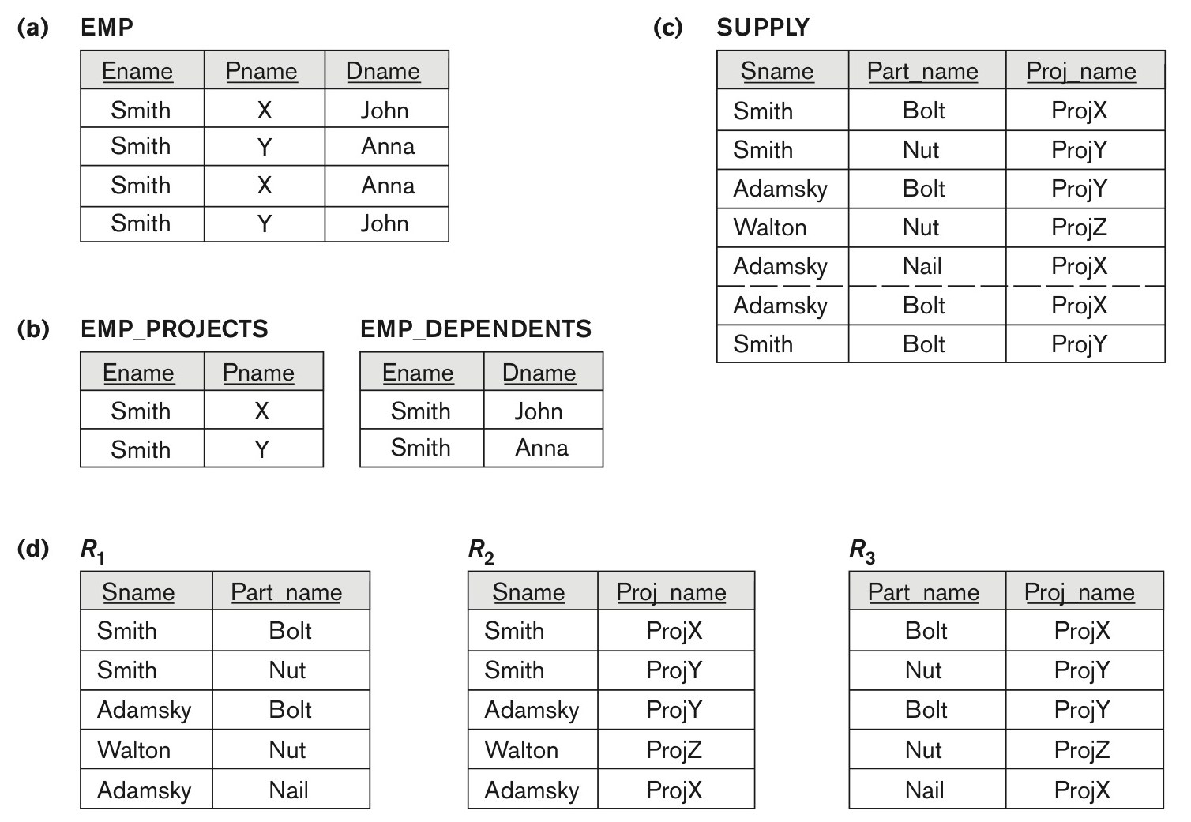
Figure 14.15 Fourth and fifth normal forms.
Figure 14.15
Fourth and fifth normal forms. (a) The EMP relation with two MVDs: Ename –>> Pname and Ename –>> Dname. (b) Decomposing the EMP relation into two 4NF relations EMP_PROJECTS and EMP_DEPENDENTS. (c) The relation SUPPLY with no MVDs is in 4NF but not in 5NF if it has the JD(R1, R2, R3). (d) Decomposing the relation SUPPLY into the 5NF relations R1, R2, R3.

Slide 63
6. Join Dependencies and Fifth Normal Form (1)
Definition:
A join dependency (JD), denoted by JD(R₁, R₂, ..., R_{n}), specified on relation schema R, specifies a constraint on the states r of R.
The constraint states that every legal state r of R should have a non-additive join decomposition into R₁, R₂, ..., R_{n}; that is, for every such r we have
* (π_{R1}(r), π_{R2}(r), ..., π_{Rn}(r)) = r
Note: an MVD is a special case of a JD where n = 2.
A join dependency JD(R₁, R₂, ..., R_{n}), specified on relation schema R, is a trivial JD if one of the relation schemas R_{i} in JD(R₁, R₂, ..., R_{n}) is equal to R.

Slide 64
Join Dependencies and Fifth Normal Form (2)
Definition:
A relation schema R is in fifth normal form (5NF) (or Project-Join Normal Form (PJNF)) with respect to a set F of functional, multivalued, and join dependencies if,
for every nontrivial join dependency JD(R₁, R₂, ..., R_{n}) in F⁺ (that is, implied by F),
every R_{i} is a superkey of R.
Discovering join dependencies in practical databases with hundreds of relations is next to impossible. Therefore, 5NF is rarely used in practice.

Slide 65
Normal Forms | Description
1NF | Any relation is said to be in 1NF if it contains only atomic values.
2NF | Any relation is said to be in 2NF only if it is in 1NF AND all other attributes except the primary key are fully functionally dependent on the primary key.
3NF | A relation is said to be in 3NF only if it is in 2NF AND there is no transition dependency between any attributes.
4NF | A relation is said to be in 4NF only if it is in BCNF(will be discussed further) and the relation doesn't consist of any multivalued dependency
5NF | A relation is said to be in 5NF only if it is in 4NF and the relation does not have any join dependency, i.e. any join performed with respect to the attributes must not cause any loss.
Dept. of AIML

Slide 67
Dept. of AIML

Slide 68
Chapter 2
SQL Data Definition and Data Types
Dept. of AIML

Slide 69
SQL Data Definition and Data Types
The name SQL is presently expanded as Structured Query Language.
SQL was called SEQUEL (Structured English QUEry Language) and was designed and implemented at IBM Research as the interface for an experimental relational database system called SYSTEM R
Dept. of AIML

Slide 70
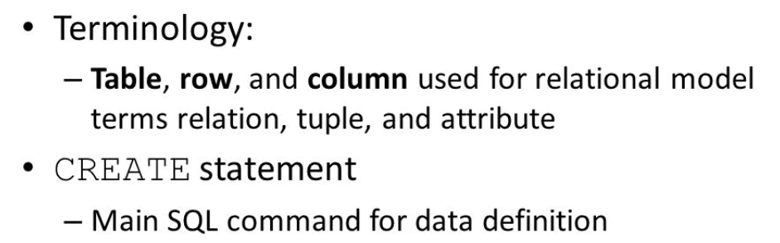
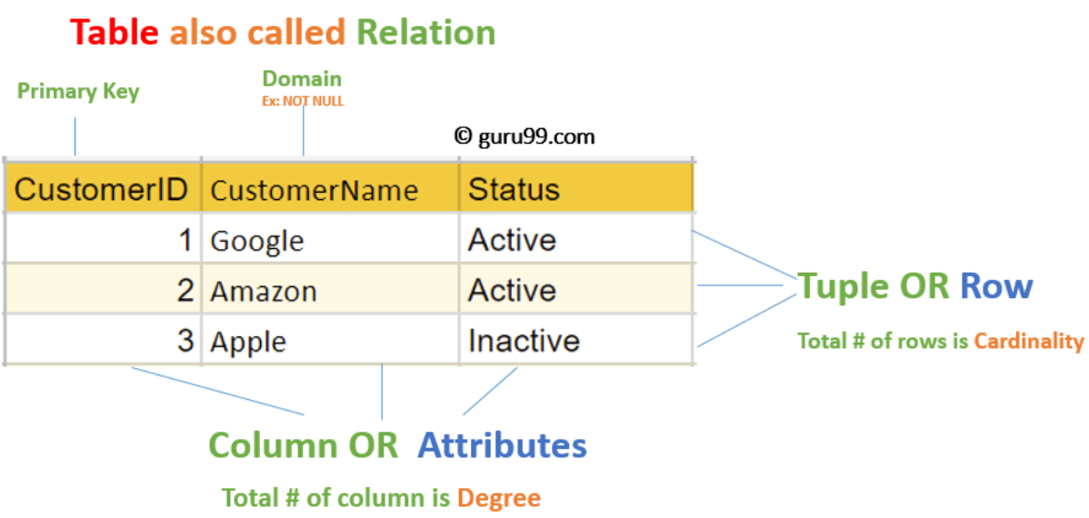
Dept. of AIML

Slide 71
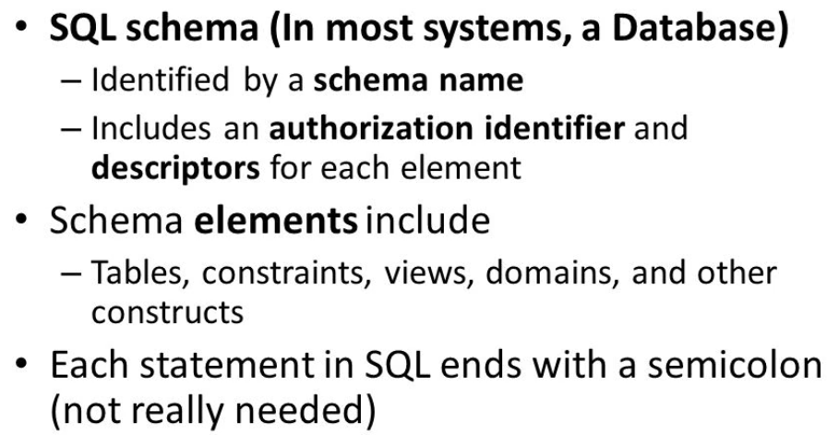
Dept. of AIML

Slide 72
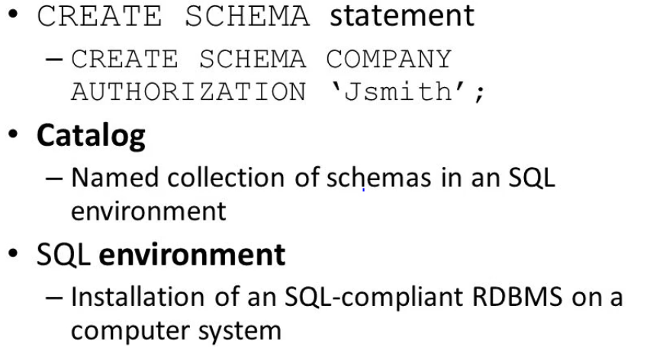
Dept. of AIML

Slide 73

Dept. of AIML

Slide 74

Dept. of AIML

Slide 75




Dept. of AIML

Slide 76

Dept. of AIML

Slide 77

Dept. of AIML

Slide 78


Dept. of AIML

Slide 79

Dept. of AIML

Slide 80

Dept. of AIML

Slide 81

Dept. of AIML

Slide 82

Dept. of AIML

Slide 83

Specifying Attribute Constraints and Attribute Defaults
NOT NULL, DEFAULT, UNIQUE
Specifying Key and Referential Integrity Constraints
PRIMARY KEY< FOREIGN KEY
Specifying Constraints on Tuples Using CHECK
CHECK
Dept. of AIML

Slide 84


Dept. of AIML

Slide 85

Dept. of AIML

Slide 86


Dept. of AIML
NULL

Slide 87

Dept. of AIML

Slide 88



Dept. of AIML

Slide 89

Dept. of AIML

Slide 90


Dept. of AIML

Slide 91

Dept. of AIML

Slide 92

Dept. of AIML

Slide 93


Slide 94

Dept. of AIML

Slide 95

Dept. of AIML

Slide 96

Dept. of AIML

Slide 97

Dept. of AIML

Slide 98

Dept. of AIML

Slide 99

Dept. of AIML

Slide 100

Dept. of AIML

Slide 101


Dept. of AIML

Slide 102
Basic Retrieval Queries in SQL
SELECT statement
One basic statement for retrieving information from a database
SQL allows a table to have two or more tuples that are identical in all their attribute values
The basic form of the SELECT statement, sometimes called a mapping or a select-from-where block, is formed of the three clauses SELECT, FROM, and WHERE and has the following form
Dept. of AIML

Slide 103
Basic Retrieval Queries in SQL
SELECT <attribute list>/<column list>
FROM <table list>
WHERE <condition> ;
<attribute list>: is a list of attribute names whose values are to be retrieved by the query
<table list>: is a list of the relation names required to process the query
<condition>: is a conditional (Boolean) expression that identifies the tuples to be retrieved by the query
Dept. of AIML

Slide 104

Basic Retrieval Queries in SQL
Dept. of AIML

Slide 105

Dept. of AIML

Slide 106

Dept. of AIML

Slide 107

Projection attribute
Selection condition
Dept. of AIML

Slide 108

Dept. of AIML

Slide 109


Dept. of AIML

Slide 110

Dept. of AIML

Slide 111
Ambiguous Attribute Names, Aliasing, Renaming, and Tuple Variables
In SQL, we can use the same name for two (or more) attributes as long as the attributes are in different relations
A query refers to two or more attributes with the same name must qualify the attribute name with the relation name by prefixing the relation name to the attribute name and separating the two by a period(.).
Example:
EMPLOYEE.LNAME, DEPARTMENT.DNAME
Dept. of AIML

Slide 112

Ambiguous Attribute Names, Aliasing, Renaming, and Tuple Variables
Example1:
prefix the attributes Name and Dnumber in Q1A to specify which ones we are referring to, because the same attribute names are used in both relations:
Dept. of AIML

Slide 113
Ambiguous Attribute Names, Aliasing, Renaming, and Tuple Variables
Example2:
Fully qualified attribute names can be used for clarity even if there is no ambiguity in attribute names. Q1 can be rewritten as Q1′ below with fully qualified attribute names
Q1′: SELECT EMPLOYEE.Fname, EMPLOYEE.LName,
EMPLOYEE.Address FROM EMPLOYEE, DEPARTMENT
WHERE DEPARTMENT.DName = ‘Research’ AND
DEPARTMENT.Dnumber = EMPLOYEE.Dno;
Dept. of AIML

Slide 114
Example3:
Some queries need to refer to the same relation twice
In this case, aliases are given to the relation name
Query 8. For each employee, retrieve the employee’s first and last name and the first and last name of his or her immediate supervisor.
Q8: SELECT E.Fname, E.Lname, S.Fname, S.Lname FROM EMPLOYEE AS E, EMPLOYEE AS S WHERE E.Super_ssn = S.Ssn;
In Q8, the alternate relation names E and S are called aliases or tuple variables for the EMPLOYEE relation
We can think of E and S as two different copies of EMPLOYEE; E represents employees in role of supervisees and S represents employees in role of supervisors
Dept. of AIML

Slide 115

Dept. of AIML

Slide 116

Example4:
Aliasing can also be used in any SQL query for convenience Can also use the AS keyword to specify aliases
Dept. of AIML

Slide 117
Unspecified WHERE Clause and Use of the Asterisk
A missing WHERE-clause indicates no condition; hence, all tuples of the relations in the FROM-clause are selected
This is equivalent to the condition WHERE TRUE
Query 9: Retrieve the SSN values for all employees.
Q9: SELECT SSN FROM EMPLOYEE
If more than one relation is specified in the FROM-clause and there is no join condition, then the CARTESIAN PRODUCT of tuples is selected
Dept. of AIML

Slide 118




Dept. of AIML

Slide 119



Dept. of AIML

Slide 120



Dept. of AIML

Slide 121

Tables as Sets in SQL
Dept. of AIML

Slide 122

Distinct keyword
Dept. of AIML

Slide 123

Dept. of AIML

Slide 124

Dept. of AIML

Slide 125

Union, Except and Intersect
Dept. of AIML

Slide 126

Dept. of AIML

Slide 127
Substring Pattern Matching and Arithmetic Operators
The LIKE comparison operator is used to compare partial strings
Two reserved characters are used: '%' (or '*' in some implementations) replaces an arbitrary number of characters, and '_' replaces a single arbitrary character
Query 25: Retrieve all employees whose address is in Houston, Texas. Here, the value of the ADDRESS attribute must contain the substring 'Houston,TX'. Q25: SELECT FNAME, LNAME FROM EMPLOYEE WHERE ADDRESS LIKE '%Houston,TX%’
Dept. of AIML

Slide 128
Query 26: Retrieve all employees who were born during the 1950s. Here, '5' must be the 8th character of the string (according to our format for date), so the BDATE value is '_______5_', with each underscore as a place holder for a single arbitrary character. Q26: SELECT FNAME, LNAME FROM EMPLOYEE WHERE BDATE LIKE '_______5_’
The LIKE operator allows us to get around the fact that each value is considered atomic and indivisible; hence, in SQL, character string attribute values are not atomic
Dept. of AIML

Slide 129
Arithmetic operations
The standard arithmetic operators '+', '-'. '*', and '/' (for addition, subtraction, multiplication, and division, respectively) can be applied to numeric values in an SQL query result
Query 27: Show the effect of giving all employees who work on the 'ProductX' project a 10% raise. Q27: SELECT FNAME, LNAME, 1.1*SALARY FROM EMPLOYEE, WORKS_ON, PROJECT WHERE SSN=ESSN AND PNO=PNUMBER AND PNAME='ProductX’
Dept. of AIML

Slide 130
Arithmetic operations
Q 14. Retrieve all employees in department 5
whose salary is between $30,000 and $40,000.
Q14: SELECT *
FROM EMPLOYEE
WHERE (Salary BETWEEN 30000 AND 40000) AND Dno = 5;
The condition (Salary BETWEEN 30000 AND 40000) in Q14
is equivalent to the condition
((Salary >= 30000) AND (Salary <= 40000))
Dept. of AIML

Slide 131
ORDER BY
The ORDER BY clause is used to sort the tuples in a query result based on the values of some attribute(s)
By default ORDER BY sorts the data in ascending order.
We can use the keyword DESC to sort the data in descending
order and the keyword ASC to sort in ascending order.
Dept. of AIML

Slide 132

ORDER BY
Dept. of AIML

Slide 133

ORDER BY
Dept. of AIML

Slide 134

Sort according to multiple columns
Dept. of AIML

Slide 135


Sort according to multiple columns
Dept. of AIML

Slide 136
Summary of SQL Queries
A query in SQL can consist of up to four clauses, but only the first two, SELECT and FROM, are mandatory. The clauses are specified in the following order: SELECT <attribute list> FROM <table list> [WHERE <condition>] [GROUP BY <grouping attribute(s)>]
Dept. of AIML

Slide 137
INSERT, DELETE, and UPDATE
Statements in SQL
There are three SQL commands to modify the database; INSERT, DELETE, and UPDATE
INSERT
In its simplest form, it is used to add one or more tuples to a relation
Attribute values should be listed in the same order as the attributes were specified in the CREATE TABLE command
Example: U1:INSERT INTO EMPLOYEE VALUES ('Richard','K','Marini', '653298653', '30-DEC-52', '98 Oak Forest,Katy,TX', 'M', 37000,'987654321', 4 )
Dept. of AIML

Slide 138
An alternate form of INSERT specifies explicitly the attribute names that correspond to the values in the new tuple
Attributes with NULL values can be left out
Example: Insert a tuple for a new EMPLOYEE for whom we only know the FNAME, LNAME, and SSN attributes. U1A: INSERT INTO EMPLOYEE (FNAME, LNAME, SSN) VALUES ('Richard', 'Marini', '653298653')
Dept. of AIML

Slide 139
DELETE
Removes tuples from a relation
Includes a WHERE-clause to select the tuples to be deleted
Tuples are deleted from only one table at a time (unless CASCADE is specified on a referential integrity constraint)
A missing WHERE-clause specifies that all tuples in the relation are to be deleted; the table then becomes an empty table
The number of tuples deleted depends on the number of tuples in the relation that satisfy the WHERE-clause
Referential integrity should be enforced
Dept. of AIML

Slide 140
DELETE
Examples: U4A: DELETE FROM EMPLOYEE WHERE LNAME='Brown’ U4B: DELETE FROM EMPLOYEE WHERE SSN='123456789’ U4C: DELETE FROM EMPLOYEE WHERE DNO IN (SELECT DNUMBER FROM DEPARTMENT WHERE DNAME='Research') U4D: DELETE FROM EMPLOYEE
Dept. of AIML

Slide 141
UPDATE
Used to modify attribute values of one or more selected tuples
A WHERE-clause selects the tuples to be modified
An additional SET-clause specifies the attributes to be modified and their new values
Each command modifies tuples in the same relation
Referential integrity should be enforced
Dept. of AIML

Slide 142
UPDATE
Example: Change the location and controlling department number of project number 10 to 'Bellaire' and 5, respectively. U5: UPDATE PROJECT SET PLOCATION = 'Bellaire', DNUM = 5 WHERE PNUMBER=10
Dept. of AIML

Slide 143
UPDATE
Example: Give all employees in the 'Research' department a 10% raise in salary. U6: UPDATE EMPLOYEE SET SALARY = SALARY *1.1 WHERE DNO IN (SELECT DNUMBER FROM DEPARTMENT WHERE DNAME='Research')
In this request, the modified SALARY value depends on the original SALARY value in each tuple
The reference to the SALARY attribute on the right of = refers to the old SALARY value before modification
The reference to the SALARY attribute on the left of = refers to the new SALARY value after modification
Dept. of AIML

